Slide 1

Management
Fourteenth Edition
Chapter 17
Being an Effective Leader
Copyright © 2018, 2016, 2014 Pearson Education, Inc. All Rights Reserved

Slide 2
Learning Objectives
17.1 Define leader and leadership.
17.2 Compare and contrast early theories of leadership.
17.3 Describe the three major contingency theories of leadership.
Develop your skill at choosing an effective leadership style.
17.4 Discuss contemporary issues affecting leadership.
Know how to prepare for an effective transition to a leadership position.
17.5 Describe twenty-first century views of leadership.

Slide 3
Are all managers leaders? Because leading is one of the four management functions, yes, ideally, all managers should be leaders. Thus, we’re going to study leaders and leadership from a managerial perspective.
Most of that research has been aimed at answering the
question: What is an effective leader?

Slide 4
Who Are Leaders and What is Leadership?
Leader: someone who can influence others and who has managerial authority
Leadership: a process of influencing a group to achieve goals
EARLY leadership theories
People have been interested in leadership since they started coming together in groups to accomplish goals. These early leadership theories focused on the leader (leadership trait theories) and how the leader interacted with his or her group members (leadership behavior theories).
Notes:
Every decision starts with a problem, a discrepancy between an existing and a desired condition. For our example, Amanda is a sales manager whose reps need new laptops because their old ones are outdated and inadequate for doing their job. To make it simple, assume it’s not economical to add memory to the old computers and it’s the company’s policy to purchase, not lease. Now we have a problem—a disparity between the sales reps’ current computers (existing condition) and their need to have more efficient ones (desired condition). Amanda has a decision to make.

Slide 5
Leadership Traits
Research focused on identifying personal characteristics that differentiated leaders from non-leaders was unsuccessful who can influence others and who has managerial authority.
It proved impossible to identify a set of traits that would always differentiate a leader (the person) from a nonleader of influencing a group to achieve goals.
Notes:
Leadership research in the 1920s and 1930s focused on isolating leader traits—that is, characteristics—that would differentiate leaders from nonleaders. Some of the traits studied included physical stature, appearance, social class, emotional stability, fluency of speech, and sociability. Despite the best efforts of researchers, it proved impossible to identify a set of traits that would always differentiate a leader (the person) from a nonleader.

Slide 6
Exhibit 17-1: Eight Traits Associated with Leadership
Trait | Description
Drive | Leaders exhibit a high effort level. They have a relatively high desire for achievement, they are ambitious, they have a lot of energy, they are tirelessly persistent in their activities, and they show initiative.
Desire to lead | Leaders have a strong desire to influence and lead others. They demonstrate the willingness to take responsibility.
Honesty and integrity | Leaders build trusting relationships with followers by being truthful or nondeceitful and by showing high consistency between word and deed.
Self-confidence | Followers look to leaders for an absence of self-doubt. Leaders, therefore, need to show self-confidence in order to convince followers of the rightness of their goals and decisions.
Intelligence | Leaders need to be intelligent enough to gather, synthesize, and interpret large amounts of information, and they need to be able to create visions, solve problems, and make correct decisions.
Job-relevant knowledge | Effective leaders have a high degree of knowledge about the company, industry, and technical matters. In-depth knowledge allows leaders to make well-informed decisions and to understand the implications of those decisions.
Extraversion | Leaders are energetic, lively people. They are sociable, assertive, and rarely silent or withdrawn.
Proneness to guilt | Guilt proneness is positively related to leadership effectiveness because it produces a strong sense of responsibility for others.
Notes:
Sources: Based on S. A. Kirkpatrick and E. A. Locke, “Leadership: Do Traits Really Matter?” Academy of Management Executive, May 1991, pp. 48–60;T. A. Judge, J. E. Bono, R. Ilies, and M. W. Gerhardt, “Personality and Leadership: A Qualitative and Quantitative Review,” Journal of Applied Psychology, August 2002, pp. 765–780; and R. L. Schaumberg and F. J. Flynn, “Uneasy Lies the Head That Wears the Crown: The Link Between Guilt Proneness and Leadership,” Journal of Personality and Social Psychology, August 2012, pp. 327–342.

Slide 7
Leadership Behaviors
Behavioral theories: leadership theories that identify behaviors that differentiate effective leaders from ineffective leaders
Notes:
Leadership research in the 1920s and 1930s focused on isolating leader traits—that is, characteristics—that would differentiate leaders from nonleaders. Some of the traits studied included physical stature, appearance, social class, emotional stability, fluency of speech, and sociability. Despite the best efforts of researchers, it proved impossible to identify a set of traits that would always differentiate a leader (the person) from a nonleader.

Slide 8
University of Iowa Studies
Autocratic style: a leader who dictates work methods, makes unilateral decisions, and limits employee participation
Democratic style: a leader who involves employees in decision-making, delegates authority, and uses feedback as an opportunity for coaching employees
Laissez-faire style: a leader who lets the group make decisions and complete the work in whatever way it sees fit
Notes:
The autocratic style described a leader who dictated work methods, made unilateral decisions, and limited employee participation. The democratic style described a leader who involved employees in decision-making, delegated authority, and used feedback as an opportunity for coaching employees. Finally, the laissez-faire style leader let the group make decisions and complete the work in whatever way it saw fit. The researchers’ results seemed to indicate that the democratic style contributed to both good quantity and quality of work.

Slide 9
Ohio State Studies
Initiating structure: the extent to which a leader defines his or her role and the roles of group members in attaining goals
Consideration: the extent to which a leader has work relationships characterized by mutual trust and respect for group members’ ideas and feelings
High–high leader: a leader high in both initiating structure and consideration behaviors
Notes:
The Ohio State studies identified two important dimensions of leader behavior. The first was called initiating structure, which referred to the extent to which a leader defined his or her role and the roles of group members in attaining goals. It included behaviors that involved attempts to organize work, work relationships, and goals. The second was called consideration, which was defined as the extent to which a leader had work relationships characterized by mutual trust and respect for group members’ ideas and feelings. A leader who was high in consideration helped group members with personal problems, was friendly and approachable, and treated all group members as equals. He or she showed concern for (was considerate of) his or her followers’ comfort, well-being, status, and satisfaction.
Research found that a leader who was high in both initiating structure and consideration (a high–high leader) sometimes achieved high group task performance and high group member satisfaction, but not always.

Slide 10
University of Michigan Studies
Two dimensions of leadership:
Employee oriented
Production oriented
Notes:
Leadership studies conducted at the University of Michigan at about the same time as those done at Ohio State also hoped to identify behavioral characteristics of leaders that were related to performance effectiveness. The Michigan group also came up with two dimensions of leadership behavior, which they labeled employee oriented and production oriented.
Leaders who were employee oriented were described as emphasizing interpersonal relationships. The production-oriented leaders, in contrast, tended to emphasize the task aspects of the job. Unlike the other studies, the Michigan researchers concluded that leaders who were employee oriented were able to get high group productivity and high group member satisfaction.

Slide 11
The Managerial Grid
Managerial grid: a two-dimensional grid for appraising leadership styles
Notes:
The behavioral dimensions from these early leadership studies provided the basis for the development of a two-dimensional grid for appraising leadership styles. This managerial grid used the behavioral dimensions “concern for people” (the vertical part of the grid) and “concern for production” (the horizontal part of the grid) and evaluated a leader’s use of these behaviors, ranking them on a scale from 1 (low) to 9 (high).
Although the grid had 81 potential categories into which a leader’s behavioral style might fall, only five styles were named: impoverished management (1,1 or low concern for production, low concern for people), task management (9,1 or high concern for production, low concern for people), middle-of-the-road management (5,5 or medium concern for production, medium concern for people), country club management (1,9 or low concern for production, high concern for people), and team management (9,9 or high concern for production, high concern for people). Of these five styles, the researchers concluded that managers performed best when using a 9,9 style.

Slide 12
Exhibit 17-2: Behavioral Theories of Leadership
Study | Behavioral Dimension | Conclusion
University of Iowa | Democratic style: involving subordinates, delegating authority, and encouraging participation Autocratic style: dictating work methods, centralizing decision making, and limiting participation Laissez-faire style: giving group freedom to make decisions and complete work | Democratic style of leadership was most effective, although later studies showed mixed results.
Ohio State | Consideration: being considerate of followers’ ideas and feelings Initiating structure: structuring work and work relationships to meet job goals | High–high leader (high in consideration and high in initiating structure) achieved high subordinate performance and satisfaction, but not in all situations.
University of Michigan | Employee oriented: emphasized interpersonal relationships and taking care of employees’ needs Production oriented: emphasized technical or task aspects of job | Employee-oriented leaders were associated with high group productivity and higher job satisfaction.
Managerial Grid | Concern for people: measured leader’s concern for subordinates on a scale of 1 to 9 (low to high) Concern for production: measured leader’s concern for getting job done on a scale of 1 to 9 (low to high) | Leaders performed best with a 9,9 style (high concern for production and high concern for people).

Slide 13
CONTINGENCY theories of leadership
we examine three contingency theories—Fiedler,
Hersey-Blanchard, and path-goal.
Each looks at defining leadership style and the situation and attempts to answer the if-then contingencies (that is, if this is the context or situation, then this is the best leadership style to use).

Slide 14
The Fiedler Model
Fiedler contingency model: a leadership theory proposing that effective group performance depends on the proper match between a leader’s style and the degree to which the situation allows the leader to control and influence
Least-preferred coworker (LPC) questionnaire: a questionnaire that measures whether a leader is task or relationship oriented.
Notes:
The first comprehensive contingency model for leadership was developed by Fred Fiedler. The Fiedler contingency model proposed that effective group performance depended on properly matching the leader’s style and the amount of control and influence in the situation. The model was based on the premise that a certain leadership style would be most effective in different types of situations. The keys were to (1) define those leadership styles and the different types of situations and then (2) identify the appropriate combinations of style and situation.
Fiedler proposed that a key factor in leadership success was an individual’s basic leadership style, either task oriented or relationship oriented. To measure a leader’s style, Fiedler developed the least-preferred coworker (LPC) questionnaire. This questionnaire contained 18 pairs of contrasting adjectives—for example, pleasant–unpleasant, cold–warm, boring–interesting, or friendly–unfriendly. Respondents were asked to think of all the coworkers they had ever had and to describe that one person they least enjoyed working with by rating him or her on a scale of 1–8 for each of the 18 sets of adjectives (the 8 always described the positive adjective out of the pair and the 1 always described the negative adjective out of the pair).

Slide 15
Fiedler’s Situational Contingencies
Leader–member relations: describes the degree of confidence, trust, and respect employees have for their leader
Task structure: describes the degree to which job assignments are formalized and structured
Position power: describes the degree of influence a leader has over activities such as hiring, firing, discipline, promotions, and salary increases
Notes:
After an individual’s leadership style had been assessed through the LPC, it was time to evaluate the situation in order to be able to match the leader with the situation. Fiedler’s research uncovered three contingency dimensions that defined the key situational factors in leader effectiveness.
• Leader-member relations – the degree of confidence, trust, and respect employees had for their leader; rated as either good or poor.
• Task structure – the degree to which job assignments were formalized and structured; rated as either high or low.
• Position power – the degree of influence a leader had over activities such as hiring, firing, discipline, promotions, and salary increases; rated as either strong or weak.

Slide 16
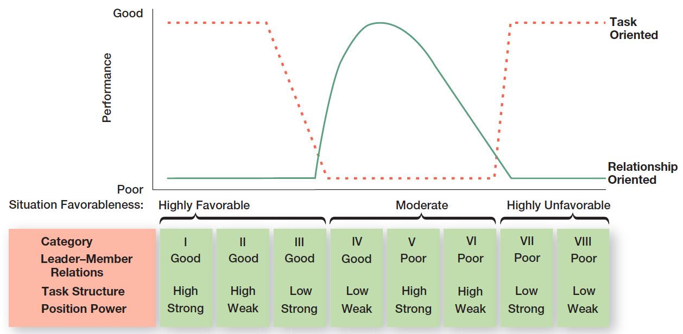
Exhibit 17-3 The Fiedler Model
Exhibit 17-3 illustrates the Fiedler Model.
Notes:
Each leadership situation was evaluated in terms of these three contingency variables, which, when combined, produced eight possible situations that were either favorable or unfavorable for the leader. (See the bottom of the chart in Exhibit 17-3.) Situations I, II, and III were classified as highly favorable for the leader. Situations IV, V, and VI were moderately favorable for the leader. And situations VII and VIII were described as highly unfavorable for the leader.
Fiedler concluded that task-oriented leaders performed better in very favorable situations and in very unfavorable situations. (See the top of Exhibit 17-3, where performance is shown on the vertical axis and situation favorableness is shown on the horizontal axis.) On the other hand, relationship-oriented leaders performed better in moderately favorable situations.

Slide 17
Hersey and Blanchard’s Situational Leadership Style
Situational leadership theory (SLT): a leadership contingency theory that focuses on followers’ readiness
Readiness: describes the degree to which job assignments are formalized and structured
Notes:
Paul Hersey and Ken Blanchard developed a leadership theory that has gained a strong following among management development specialists. This model, called situational leadership theory (SLT), is a contingency theory that focuses on followers’ readiness.
Regardless of what the leader does, the group’s effectiveness depends on the actions of the followers. This important dimension
has been overlooked or underemphasized in most leadership theories. And readiness, as defined by Hersey and Blanchard, refers to the extent to which people have the ability and willingness to accomplish a specific task.

Slide 18
SLT Leadership Styles
Telling (high task–low relationship) The leader defines roles and tells people what, how, when, and where to do various tasks.
Selling (high task–high relationship) The leader provides both directive and supportive behavior.
Participating (low task–high relationship) The leader and followers share in decision making; the main role of the leader is facilitating and communicating
Delegating (low task–low relationship) The leader provides little direction or support.
Notes:
SLT uses the same two leadership dimensions that Fiedler identified: task and relationship behaviors. However, Hersey and Blanchard go a step further by considering each as either high or low and then combining them into four specific leadership styles described as follows:
• Telling (high task–low relationship): The leader defines roles and tells people what, how, when, and where to do various tasks.
• Selling (high task–high relationship): The leader provides both directive and supportive behavior.
• Participating (low task–high relationship): The leader and followers share in decision-making; the main role of the leader is facilitating and communicating.
• Delegating (low task–low relationship): The leader provides little direction or support.

Slide 19
Four Stages of Follower Readiness
R1: both unable and unwilling
R2: unable but willing
R3: able but unwilling
R4: both able and willing
Notes:
The final component in the model is the four stages of follower readiness:
R1: People are both unable and unwilling to take responsibility for doing something. Followers aren’t competent or confident.
R2: People are unable but willing to do the necessary job tasks. Followers are motivated but lack the appropriate skills.
R3: People are able but unwilling to do what the leader wants. Followers are competent, but don’t want to do something.
R4: People are both able and willing to do what is asked of them.

Slide 20
Path-Goal Model
Path-goal theory: a leadership theory that says the leader’s job is to assist followers in attaining their goals and to provide direction or support needed to ensure that their goals are compatible with the goals of the group or organization
Notes:
Another approach to understanding leadership is path-goal theory, which states that the leader’s job is to assist followers in attaining their goals and to provide direction or support needed to ensure that their goals are compatible with the goals of the group or organization. Developed by Robert House, path-goal theory takes key elements from the expectancy theory of motivation. The term path-goal is derived from the belief that effective leaders remove the roadblocks and pitfalls so that followers have a clearer path to help them get from where they are to the achievement of their work goals.

Slide 21
Four Leadership Behaviors
Directive leader
Supportive leader
Participative leader
Achievement-oriented leader
Notes:
House identified four leadership behaviors:
Directive leader: Lets subordinates know what’s expected of them, schedules work to be done, and gives specific guidance on how to accomplish tasks.
Supportive leader: Shows concern for the needs of followers and is friendly.
Participative leader: Consults with group members and uses their suggestions before making a decision.
Achievement oriented leader: Sets challenging goals and expects followers to perform at their highest level.
In contrast to Fiedler’s view that a leader couldn’t change his or her behavior, House assumed that leaders are flexible and can display any or all of these leadership styles depending on the situation.

Slide 22
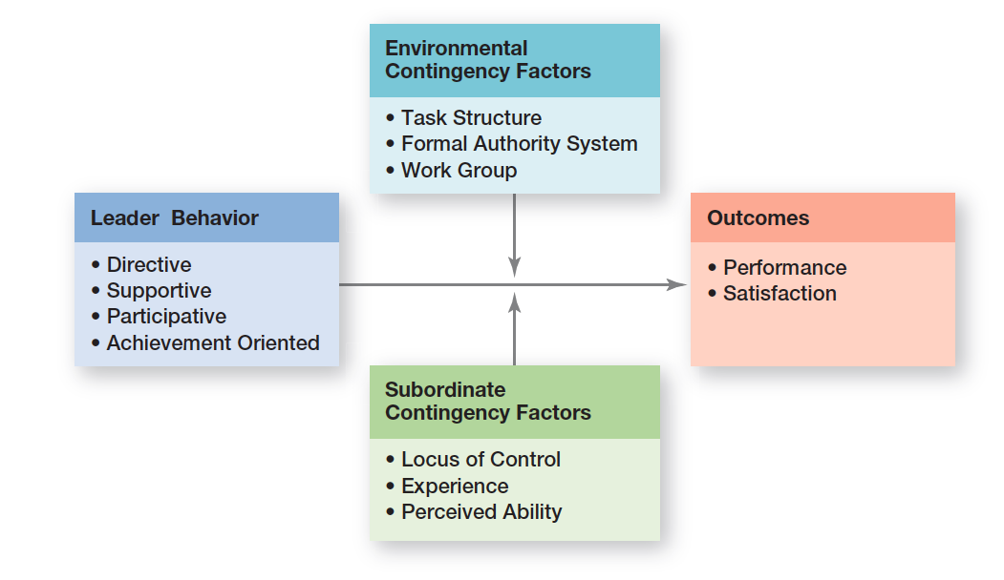
Exhibit 17-4 Path-Goal Model
Exhibit 17-4 illustrates that path-goal theory proposes two situational or contingency variables that moderate the leadership behavior–outcome relationship.
Notes:
As Exhibit 17-4 illustrates, path-goal theory proposes two situational or contingency variables that moderate the leadership behavior–outcome relationship: those in the environment that are outside the control of the follower (factors including task structure, formal authority system, and the work group) and those that are part of the personal characteristics of the follower (including locus of control, experience, and perceived ability).

Slide 23
Leader-Member Exchange (LMX) Theory
Leader-member exchange theory (LMX): the leadership theory that says leaders create in-groups and out-groups and those in the in-group will have higher performance ratings, less turnover, and greater job satisfaction
Notes:
Leader–member exchange theory (LMX) says leaders create in-groups and out-groups and those in the in-group will have higher performance ratings, less turnover, and greater job satisfaction. LMX theory suggests that early on in the relationship between a leader and a given follower, a leader will implicitly categorize a follower as an “in” or as an “out.” That relationship tends to remain fairly stable over time. Leaders also encourage LMX by rewarding those employees with whom they want a closer linkage and punishing those with whom they do not.

Slide 24
Transformational/Transactional Leadership
Transactional leaders: leaders who lead primarily by using social exchanges (or transactions)
Transformational leaders: leaders who stimulate and inspire (transform) followers to achieve extraordinary outcomes
Notes:
Many early leadership theories viewed leaders as transactional leaders; that is, leaders who lead primarily by using social exchanges (or transactions). Transactional leaders guide or motivate followers to work toward established goals by exchanging rewards for their productivity. But another type of leader—a transformational leader—stimulates and inspires (transforms) followers to achieve extraordinary outcomes.

Slide 25
Charismatic-Visionary Leadership
Charismatic leader: an enthusiastic, self-confident leader whose personality and actions influence people to behave in certain ways
Visionary leadership: the ability to create and articulate a realistic, credible, and attractive vision of the future that improves upon the present situation
Notes:
A charismatic leader is an enthusiastic, self-confident leader whose personality and actions influence people to behave in certain ways. Several authors have attempted to identify personal characteristics of the charismatic leader. The most comprehensive analysis identified five such characteristics: they have a vision, the ability to articulate that vision, a willingness to take risks to achieve that vision, a sensitivity to both environmental constraints and follower needs, and behaviors that are out of the ordinary.
Although the term vision is often linked with charismatic leadership, visionary leadership is different; it’s the ability to create and articulate a realistic, credible, and attractive vision of the future that improves on the present situation. This vision, if properly selected and implemented, is so energizing that it “in effect jump-starts the future by calling forth the skills, talents, and resources to make it happen.”

Slide 26
Authentic Leadership
Authentic leadership: leaders who know who they are, know what they believe in, and act on those values and beliefs openly and candidly
Notes:
Authentic leadership focuses on the moral aspects of being a leader. Authentic leaders know who they are, know what they believe in, and act on those values and beliefs openly and candidly.

Slide 27
Ethical Leadership
An ethical leader puts public safety ahead of profits, holds culpable employees accountable, and creates a culture in which employees feel that they could and should do a better job.
Notes:
Mary Barra is an example of an ethical leader because she is placing public safety ahead of profits. She is holding culpable employees accountable, and she stands behind her employees by creating a culture in which they feel that they could and should do a better job.

Slide 28
Team Leadership
Many leaders are not equipped to handle the change to employee teams.
Two priorities:
Managing team’s external boundary
Facilitating team process
Notes:
Because leadership is increasingly taking place within a team context and more organizations are using work teams, the role of the leader in guiding team members has become increasingly important. The role of team leader is different from the traditional leadership role.
Many leaders are not equipped to handle the change to employee teams. As one consultant noted, “Even the most capable managers have trouble making the transition because all the command-and-control type things they were encouraged to do before are no longer appropriate.”
One study looking at organizations that reorganized themselves around employee teams found certain common responsibilities of all leaders. These leader responsibilities included coaching, facilitating, handling disciplinary problems, reviewing team and individual performance, training, and communication. However, a more meaningful way to describe the team leader’s job is to focus on two priorities: (1) managing the team’s external boundary and (2) facilitating the team process. These priorities entail four specific leadership roles, which are identified in Exhibit 17-5.

Slide 29
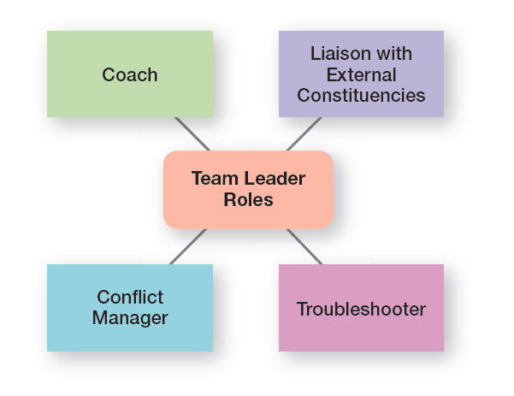
Exhibit 17-5 Team Leadership Roles
Exhibit 17-4 illustrates the four specific leadership roles.

Slide 30
Managing Power (1 of 2)
Legitimate power: the power a leader has as a result of his or her position in the organization
Coercive power: the power a leader has to punish or control
Reward power: the power a leader has to give positive rewards
Notes:
Where do leaders get their power—that is, their right and capacity to influence work actions or decisions? Five sources of leader power have been identified: legitimate, coercive, reward, expert, and referent.
Legitimate power and authority are the same. Legitimate power represents the power a leader has as a result of his or her position in the organization. Although people in positions of authority are also likely to have reward and coercive power, legitimate power is broader than the power to coerce and reward.
Coercive power is the power a leader has to punish or control. Followers react to this power out of fear of the negative results that might occur if they don’t comply. Managers typically have some coercive power, such as being able to suspend or demote employees or to assign them work they find unpleasant or undesirable.
Reward power is the power to give positive rewards. A reward can be anything a person values such as money, favorable performance appraisals, promotions, interesting work assignments, friendly colleagues, and preferred work shifts or sales territories.

Slide 31
Managing Power (2 of 2)
Expert power: power that’s based on expertise, special skills, or knowledge
Referent power: power that arises because of a person’s desirable resources or personal traits
Notes:
Expert power is power based on expertise, special skills, or knowledge. If an employee has skills, knowledge, or expertise that’s critical to a work group, that person’s expert power is enhanced.
Finally, referent power is the power that arises because of a person’s desirable resources or personal traits. If I admire you and want to be associated with you, you can exercise power over me because I want to please you. Referent power develops out of admiration of another and a desire to be like that person.

Slide 32
Developing Trust
Credibility: the degree to which followers perceive someone as honest, competent, and able to inspire
Trust: the belief in the integrity, character, and ability of a leader
Notes:
“Honesty is absolutely essential to leadership. If people are going to follow someone willingly, whether it be into battle or into the boardroom, they first want to assure themselves that the person is worthy of their trust.” In addition to being honest, credible leaders are competent and inspiring. They are personally able to effectively communicate their confidence and enthusiasm. Thus, followers judge a leader’s credibility in terms of his or her honesty, competence, and ability to inspire.
Trust is closely entwined with the concept of credibility, and, in fact, the terms are often used interchangeably. Trust is defined as the belief in the integrity, character, and ability of a leader. Followers who trust a leader are willing to be vulnerable to the leader’s actions because they are confident that their rights and interests will not be abused.

Slide 33
Five Dimensions of Trust
Integrity
Competence
Consistency
Loyalty
Openness
Notes:
Research has identified five dimensions that make up the concept of trust:
• Integrity: honesty and truthfulness
• Competence: technical and interpersonal knowledge and skills
• Consistency: reliability, predictability, and good judgment in handling situations
• Loyalty: willingness to protect a person, physically and emotionally
• Openness: willingness to share ideas and information freely
Of these five dimensions, integrity seems to be the most critical when someone assesses another’s trustworthiness.

Slide 34
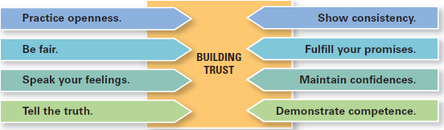
Exhibit 17-6 Building Trust
Exhibit 17-6 offers some suggestions for how leaders can build trust.
Notes:
Given the importance of trust to effective leadership, how can leaders build trust? Exhibit 17-6 lists some suggestions.

Slide 35
Empowering Employees
Empowerment involves increasing the decision-making discretion of workers. Millions of individual employees and employee teams are making the key operating decisions that directly affect their work.
Notes:
They’re developing budgets, scheduling workloads, controlling inventories, solving quality problems, and engaging in similar activities that until very recently were viewed exclusively as part of the manager’s job.

Slide 36
Leading Across Cultures
Effective leaders do not use a single style. They adjust their style to the situation.
National culture is certainly an important situational variable in determining which leadership style will be most effective.
Notes:
One general conclusion that surfaces from leadership research is that effective leaders do not use a single style. They adjust their style to the situation. Although not mentioned explicitly, national culture is certainly an important situational variable in determining which leadership style will be most effective. What works in China isn’t likely to be effective in France or Canada. For instance, one study of Asian leadership
styles revealed that Asian managers preferred leaders who were competent decision makers, effective communicators, and supportive of employees.
National culture affects leadership style because it influences how followers will respond. Leaders can’t (and shouldn’t) just choose their styles randomly. They’re constrained by the cultural conditions their followers have come to expect.

Slide 37
Exhibit 17-7: Cross-Cultural Leadership
Examples
Korean leaders are expected to be paternalistic toward employees.
Arab leaders who show kindness or generosity without being asked to do so are seen by other Arabs as weak.
Chinese leaders are expected to stay positive when facing attacks.
European leaders are expected to be more action oriented.
Japanese leaders are expected to be humble and speak frequently.
Latin American leaders should not feel rejected when others behave formally.
Scandinavian and Dutch leaders who single out individuals with public praise are likely to embarrass, not energize, those individuals.
Effective leaders in Malaysia are expected to show compassion while using more of an autocratic than a participative style.
Effective German leaders are characterized by high performance orientation, low compassion, low self-protection, low team orientation, high autonomy, and high participation.
Effective leaders in Sub-Saharan Africa build deep relationships and close teamwork.
Notes:
Given the importance of trust to effective leadership, how can leaders build trust? Exhibit 17-6 lists some suggestions.
Sources: Based on “Leadership Across Cultures,” Harvard Business Review, www.hbr.org, May 2015; J. C. Kennedy, “Leadership in Malaysia: Traditional Values, International Outlook,” Academy of Management Executive, August 2002, pp. 15–17; F. C. Brodbeck, M. Frese, and M. Javidan, “Leadership Made in Germany: Low on Compassion, High on Performance,” Academy of Management Executives, February 2002, pp. 16–29; M. F. Peterson and J. G. Hunt, “International Perspectives on International Leadership,” Leadership Quarterly, Fall 1997, pp. 203–231; R. J. House and R. N. Aditya, “The Social Scientific Study of Leadership: Quo Vadis?” Journal of Management, vol. 23, no. 3, 1997, p. 463; and R. J. House, “Leadership in the Twenty-First Century,” in The Changing Nature of Work, ed. A Howard (San Francisco: Jossey-Bass, 1995), p. 442.

Slide 38
Becoming an Effective Leader
Leader training
Substitutes for leadership
Notes:
Evidence indicates that leadership training is more likely to be successful with individuals who are high self-monitors than with low self-monitors.
Such individuals have the flexibility to change their behavior as different situations may require. In addition, organizations may find that individuals with higher levels of a trait called motivation to lead are more receptive to leadership development opportunities.
Certain individual, job, and organizational variables can act as “substitutes for leadership,” negating the influence of the leader. For instance, follower characteristics such as experience, training, professional orientation, or need for independence can neutralize the effect of leadership. These characteristics can replace the employee’s need for a leader’s support or ability to create structure and reduce task ambiguity. Similarly, jobs that are inherently unambiguous and routine or intrinsically satisfying may place fewer demands on leaders. Finally, such organizational characteristics as explicit formalized goals, rigid rules and procedures, or cohesive work groups can substitute for formal leadership.

Slide 39
Review Learning Objective 17.1
Define leader and leadership.
A leader influences and has authority
Leadership involves influencing a group to achieve its goal
Leading is a function of management
Notes:
A leader is someone who can influence others and who has managerial authority. Leadership is a process of leading a group and influencing that group to achieve its goals. Managers should be leaders because leading is one of the four management functions.

Slide 40
Review Learning Objective 17.2
Compare and contrast early theories of leadership.
University of Iowa studies
Ohio State studies
University of Michigan studies
Managerial grid
Notes:
Early attempts to define leadership traits were unsuccessful although later attempts found seven traits associated with leadership. The University of Iowa studies explored three leadership styles. The only conclusion was that group members were more satisfied under a democratic leader than under an autocratic one.
The Ohio State studies identified two dimensions of leader behavior—initiating structure and consideration. A leader high in both those dimensions at times achieved high group task performance and high group member satisfaction, but not always.
The University of Michigan studies looked at employee oriented leaders and production oriented leaders. They concluded that leaders who were employee oriented could get high group productivity and high group member satisfaction.
The Managerial Grid looked at leaders’ concern for production and concern for people, and identified five leader styles. Although it suggested that a leader who was high in concern for production and high in concern for people was the best, there was no substantive evidence for that conclusion. As the behavioral studies showed, a leader’s behavior has a dual nature: a focus on the task and a focus on the people.

Slide 41
Review Learning Objective 17.3
Describe the three major contingency theories of leadership.
Fiedler’s model
Hersey and Blanchard’s situational leadership theory
Path goal model, Robert House
Notes:
Fiedler’s model attempted to define the best style to use in particular situations. He measured leader style—relationship oriented or task oriented—using the least-preferred coworker questionnaire. Fiedler also assumed a leader’s style was fixed. He measured three contingency dimensions: leader–member relations, task structure, and position power. The model suggests that task oriented leaders performed best in very favorable and very unfavorable situations, and relationship-oriented leaders performed best in moderately favorable situations.
Hersey and Blanchard’s situational leadership theory focused on followers’ readiness. They identified four leadership styles: telling (high task-low relationship), selling (high task-high relationship), participating (low task-high relationship), and delegating (low task-low relationship). They also identified four stages of readiness: unable and unwilling (use telling style), unable but willing (use selling style), able but unwilling (use participative style), and able and willing (use delegating style).
The path-goal model developed by Robert House identified four leadership behaviors: directive, supportive, participative, and achievement-oriented. He assumed that a leader can and should be able to use any of these styles. The two situational contingency variables were found in the environment and in the follower. Essentially the path-goal model says that a leader should provide direction and support as needed; that is, structure the path so the followers can achieve goals.

Slide 42
Review Learning Objective 17.4
Discuss contemporary issues affecting leadership.
Leader-membership exchange theory (LMX)
Transactional/transformational leader
Charismatic/visionary leader
Authentic leadership
Ethical leadership
Team leader
Notes:
Leader-member exchange theory (LMX) says that leaders create in-groups and outgroups and those in the in-group will have higher performance ratings, less turnover, and greater job satisfaction. A transactional leader exchanges rewards for productivity where a transformational leader stimulates and inspires followers to achieve goals.
A charismatic leader is an enthusiastic and self-confident leader whose personality and actions influence people to behave in certain ways. People can learn to be charismatic. A visionary leader is able to create and articulate a realistic, credible, and attractive vision of the future. A team leader has two priorities: manage the team’s external boundary and facilitate the team process. Four leader roles are involved: liaison with external constituencies, troubleshooter, conflict manager, and coach.

Slide 43
Review Learning Objective 17.5
Describe twenty-first century views of leadership.
Fiver sources of a leader’s power
Issues of:
managing power
developing trust
empowering employees
leading across cultures
becoming an effective leader
Notes:
The five sources of a leader’s power are legitimate (authority or position), coercive (punish or control), reward (give positive rewards), expert (special expertise, skills, or knowledge), and referent (desirable resources or traits). Today’s leaders face the issues of managing power, developing trust, empowering employees, leading across cultures, and becoming an effective leader.

Slide 44

Copyright

